Slide 1
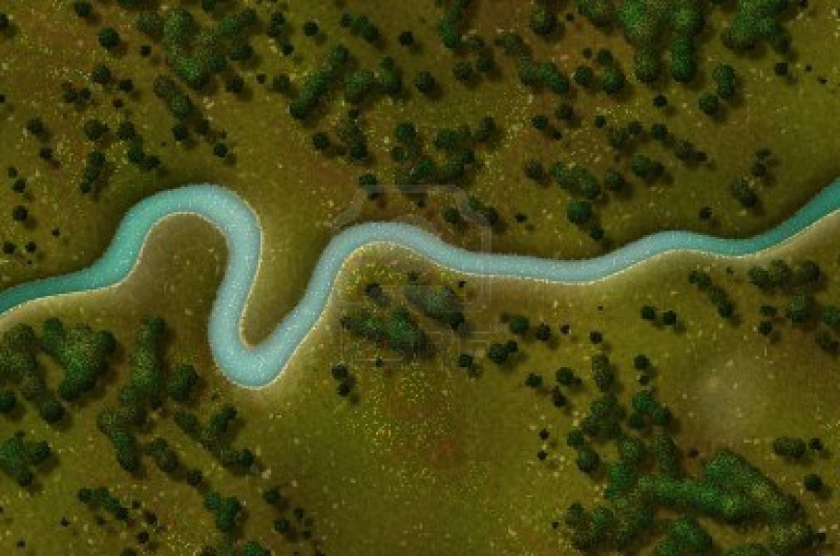
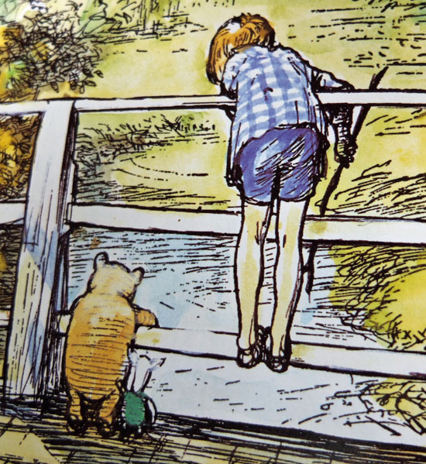
Virtual ‘Pooh sticks’

Slide 2
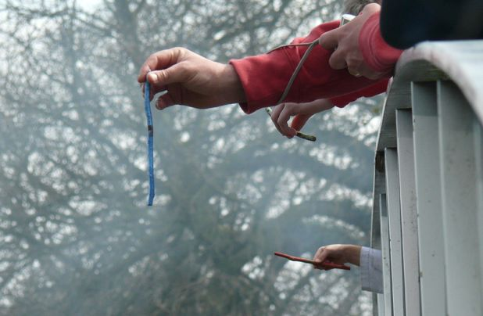
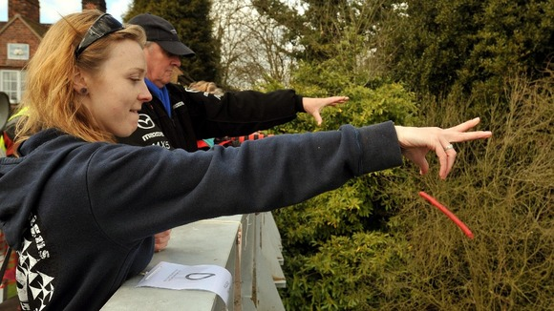
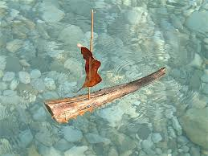
Pooh sticks – described in the Winnie-the-Pooh book (Milne) is a simple sport played on a bridge over running water; each player drops a stick on the upstream side of a bridge and the one whose stick first appears on the downstream side is the winner!
You are invited to play God and design the ultimate river to improve your chances winning a game of virtual pooh sticks
but do you know how to do it?

Slide 3
Background
There are many different river types e.g., meandering, braided, anastomosing etc these forms are controlled by 3 main variables;
Gradient – the steepness of the slope
Discharge – amount of water flowing down the stream
Sediment load – the size and amount of the particles in the river from fine clays and silts to sand and pebbles and boulders
The relationships between the variables are explained by Lanes Balance:
If the discharge increases – then the gradient increases as the river degrades (erodes) its channel
If the sediment load increases – then there is aggradation (deposition) in its channel and/or floodplain, which changes the gradient of the river
If the grain size becomes much coarser degradation may change to aggradation
3 simple videos to explain this?
This delicate balance of erosion and deposition creates different river types – but which river type will make your Pooh stick travel the fastest?

Slide 4
Gradient

Slide 5
Design your own River
Gradient
1 10
Flat
Steep
Race Pooh stick
Discharge
1 10
Low
High
Sediment load
1 10
Fine
Coarse

Slide 6
Video plays of stick travelling down river – 10 different videos – with a timer in the corner + 10 resulting end screens
 |  |  |  |  |  |  | speed
1 | creates a chain of ponds - stick stuck in pond |  |  |  |  |  | 30 s
2 | channel with floodout - slow then stuck |  |  |  |  |  | 25s
3 | anastomsing river - stick slow on bracnching |  |  |  |  |  | 20s
4 | anabranching river (larger grain size) slow |  |  |  |  |  | 20s
5 | fine grain meandering - med but gets delayed by point bars |  |  |  |  |  | 15s
6 | coarse grain measndering - med slightly quicker than fine |  |  |  |  |  | 10s
7 | with high discharge (9-10) meandering but cutoffs make it quick |  |  |  |  |  | 5s
8 | wandering gravel bed - stick gets stuck in gravel |  |  |  |  |  | 15s
9 | braided - stick gets stuck on bars |  |  |  |  |  | 20 s
10 | Steep pool and cascades - stick get trapped in pools |  |  |  |  |  | 25s
Attempt counter – after 4 attempts automatically takes them to help screen each time

Slide 7
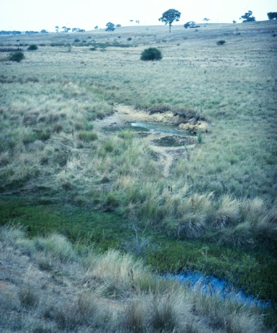
Resulting end screen 1
30
:
00
secs
You created a ‘Chain of ponds’
This is a discontinuous channel so your stick got stuck in the ponds and slowed its progress – think about trying to create a continuous channel by increasing its energy?
Start again

Slide 8
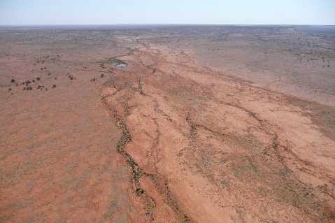
Resulting end screen 2
25
:
00
secs
You created a channel with a ‘floodout’
This is a discontinuous channel so your stick was slowed then got stuck in the marshes– think about trying to create a continuous channel by increasing its energy?
Start again

Slide 9
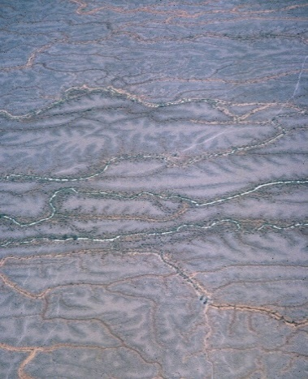
Resulting end screen 3
20
:
00
secs
You created an anastomosing channel
Your stick was diverted by the numerous anabranching channels that dissect from the main channel– try to reduce the rivers ability to split from its trunk channel by increasing its energy?
Start again

Slide 10
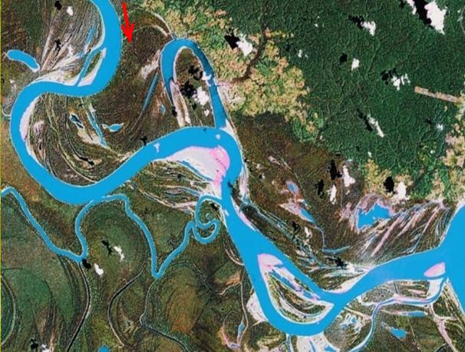
Resulting end screen 4
20
:
00
secs
You created an anabranching river
Your stick was diverted by the numerous anabranching channels that dissect from the main channel– try to reduce the rivers ability to split from its trunk channel by increasing its energy?
Start again

Slide 11
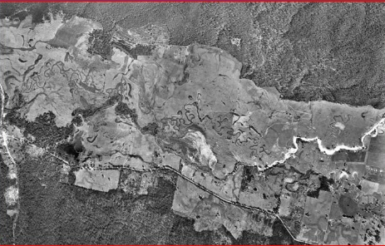
Resulting end screen 5
15
:
00
secs
You created a fine grained meandering river
Your stick was initially fast with no in-channel bars to obstruct its progress but was slightly slowed by large point bars on each meander – try to reduce the number of depositional features and meanders by increasing its energy?
Start again

Slide 12
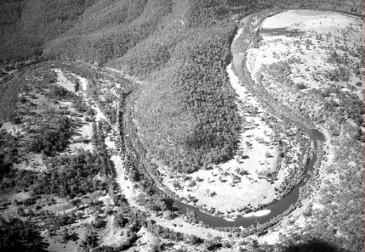
Resulting end screen 6
10
:
00
secs
You created a coarse grained meandering river
Your stick was fast with no in-channel bars to obstruct its progress but was slightly slowed by the number and size of meanders – try to reduce the number of meanders by increasing its energy?
Start again

Slide 13
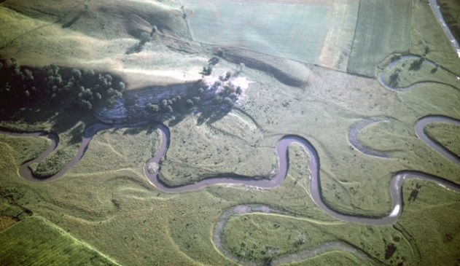
Resulting end screen 7
5
:
00
secs
You created a meandering channel with many cut-offs
Congratulations!!
Initially your stick was slowed by the meanders but then it took a short cut down the numerous cut-offs and dramatically increased in speed – your stick won the race!!

Slide 14
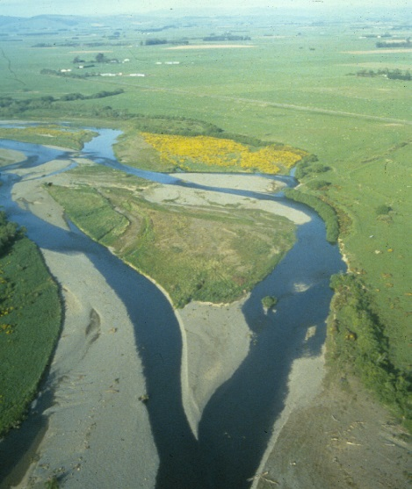
Resulting end screen 8
15
:
00
secs
You created a wandering gravel bed
This is a high energy channel so initially your stick travelled very fast but then got stuck on the wandering gravel bed in the central reach and slowed its progress – think about trying to reduce gravel bars in the channel by reducing its energy
Start again

Slide 15
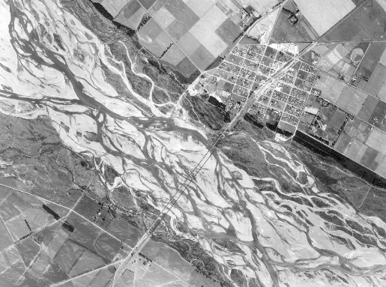
Resulting end screen 9
20
:
00
secs
You created a braided river
This is a high energy channel so initially your stick travelled very fast but then got stuck on the numerous sand bars and slowed its progress – think about trying to reduce the number of bars in the channel by reducing its energy?
Start again

Slide 16
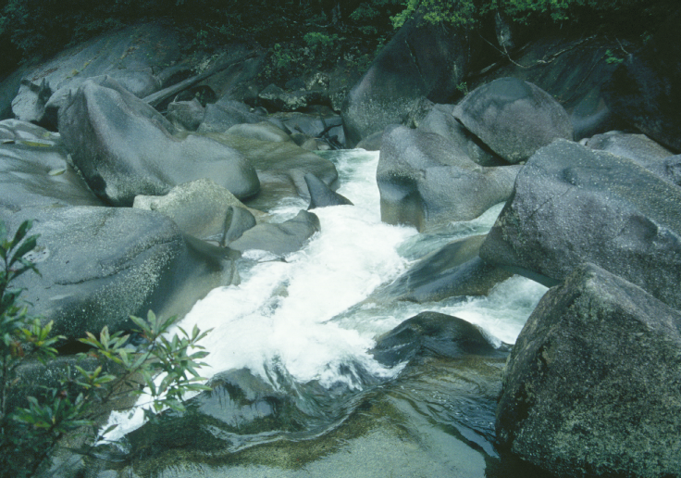
Resulting end screen 10
25
:
00
secs
You created steep pools and cascades
This is a high energy erosive channel formed in bedrock so your stick got trapped in the high energy pools and slowed its progress – think about trying to create a more even channel by reducing its energy?
Start again

Slide 17
Help screen after 4 failed attempts
River types created
Discharge
Sediment load
Gradient
High discharge
Coarse
High energy/ high gradient
Which river type would make your stick travel the fastest bearing in mind potential obstacles created?
decreasing stream power (discharge)
Fines and coarse
decreasing sediment calibre
decreasing gradient
Low discharge
Fines
Low energy/ low gradient

